Slide 1
Project Proposal
Xinran Chen, Tianyu Han, Ying Hong, Siyu Shen, Shiyuan Xu
From Columbia MS Data Science

Slide 2
What is Psoriasis?
Psoriasis is a chronic immune-mediated inflammatory skin disease. Psoriasis is generally thought to be a genetic disease that is triggered by environmental factors.

Slide 3
Objective
Goal
Using NHANES (from 2003 To 2004) to learn the underlying patterns in psoriasis patients and accurately identify patients
Challenges
Need domain knowledge input
Organize data into one analytics dataset
Build Machine learning model
Check if model results align with domain knowledge
Plan

Slide 4
Data Overview
From 2003-2004 NHANES Dermatology Exam Data:
2992 examination objects
140 psoriasis patients
Consider resampling the data since the dataset is imbalanced

Slide 5
Data Preparation- from Literature Review
Target variable:
psoriasis / no psoriasis (binary classification)
self- reported body surface affected (BSA) (regression or multi-classification)
PASI score: psoriasis area and severity index (if possible)

Slide 6
Data Preparation- from Literature Review
Demographic features:
Demographics
Age
Gender
Race
BMI
Self-reported features:
Smoking status
Alcohol consumption
Physical activity

Slide 7
Data Preparation- from Literature Review
Dietary features:
Vitamin D intake
Oral vitamin D supplementation
Calcium intake
Examination features:
CRP level: C-reactive protein
Blood 25[OH]D: 25 hydroxyvitamin D
1alpha OHD
alfa-calcidol

Slide 8
Data Preparation- from Literature Review
Comorbidity features:
Immune disease
Inflammation disease
MetS: Metabolic disease
Cardiovascular
Obesity
Diabetes (Type II)
Cardio-metabolic disease
Other psoriasis related comorbidities? (need domain knowledge input)

Slide 9
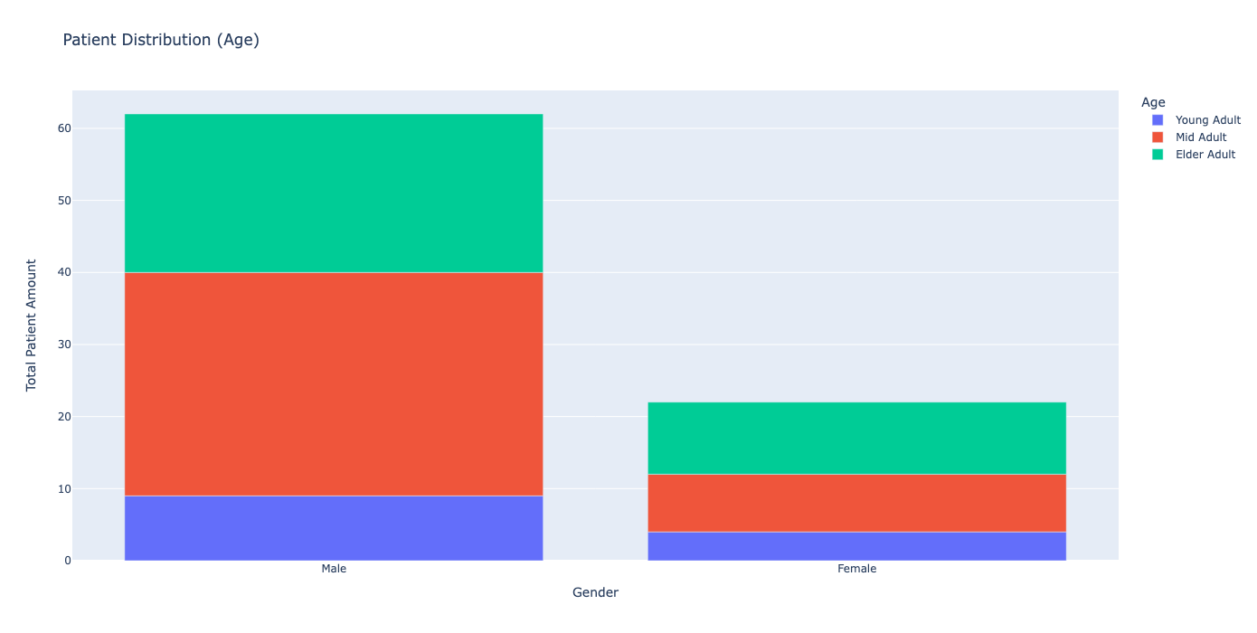
Data Exploration-Age Distribution

Slide 10
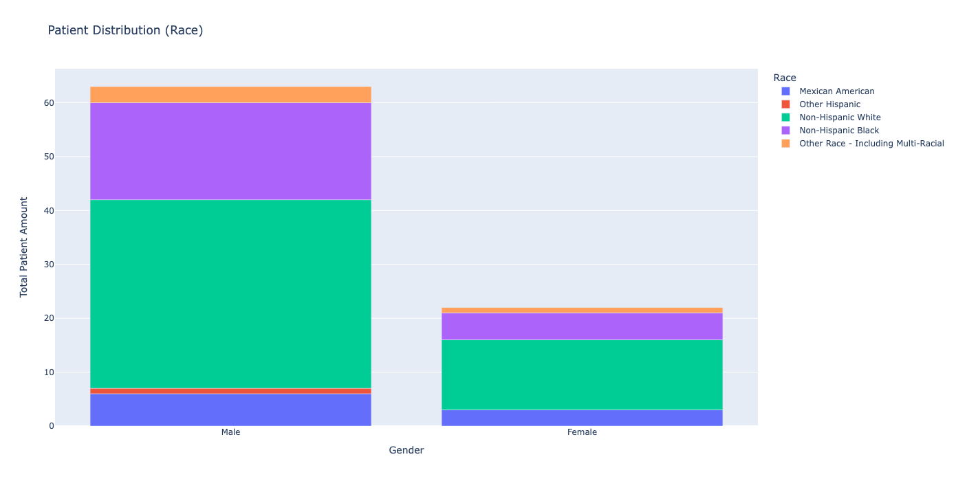
Data Exploration- Race Distribution

Slide 11
Machine Learning Model
Logistic Regression,
Random Forests,
XGBoost,
SVM

Slide 12
Next Steps
Improve analytics dataset (add more features- comorbidities, etc.)
Build classification model

